Slide 1





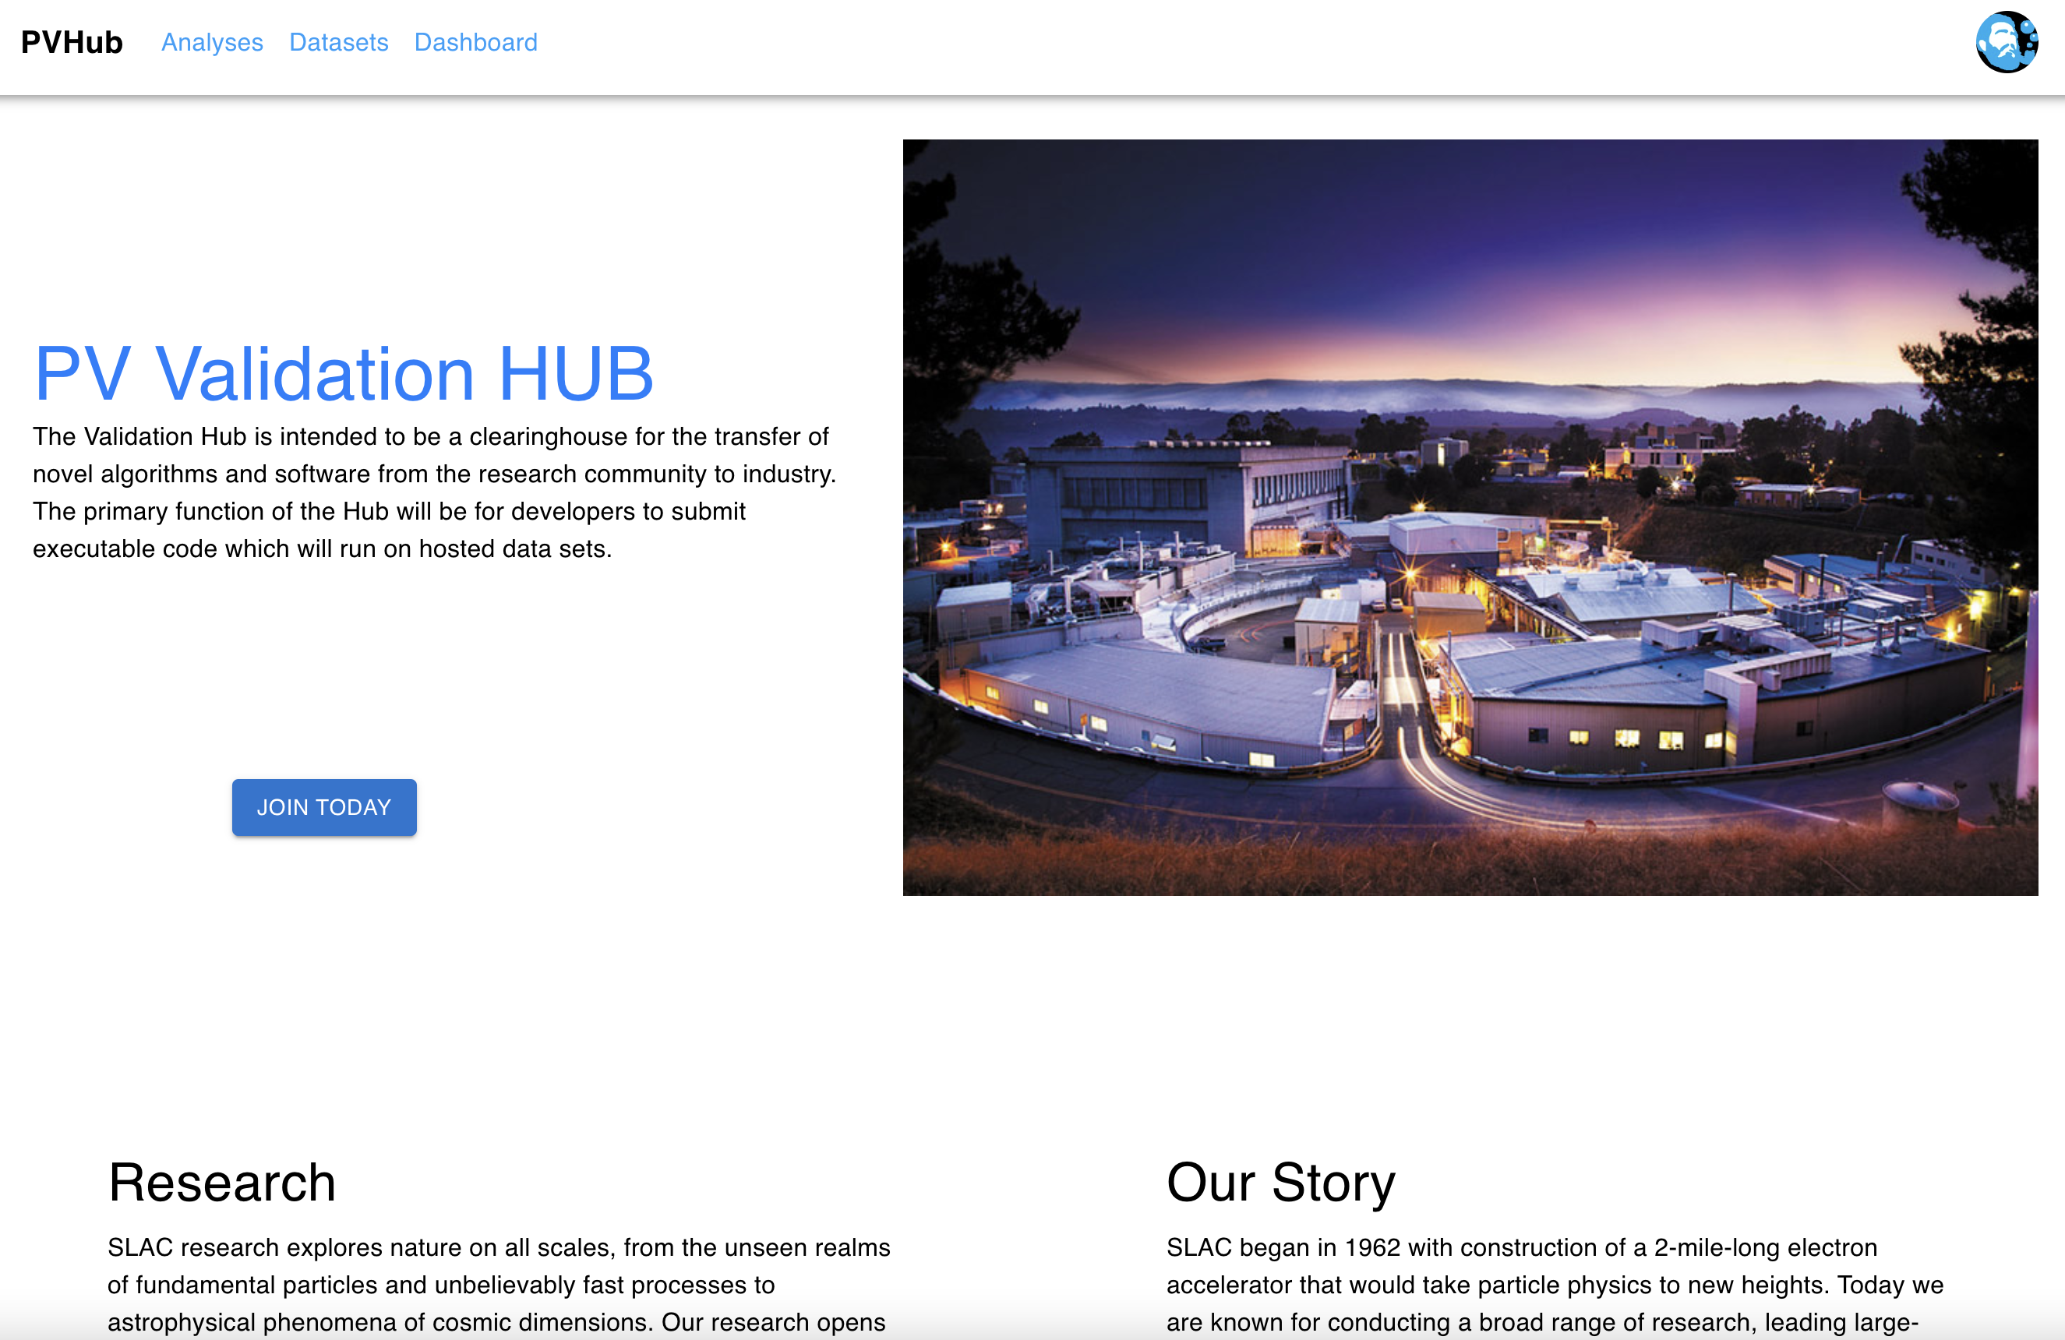
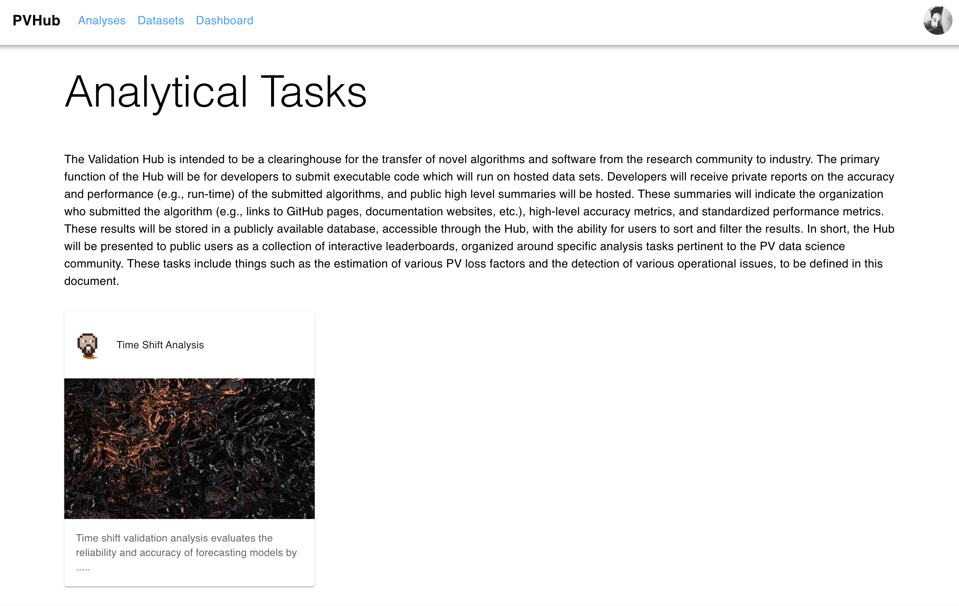
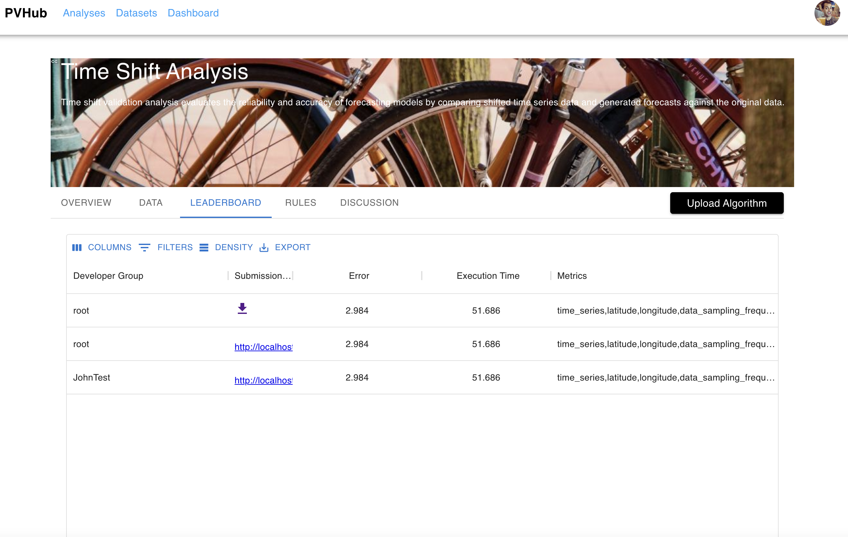
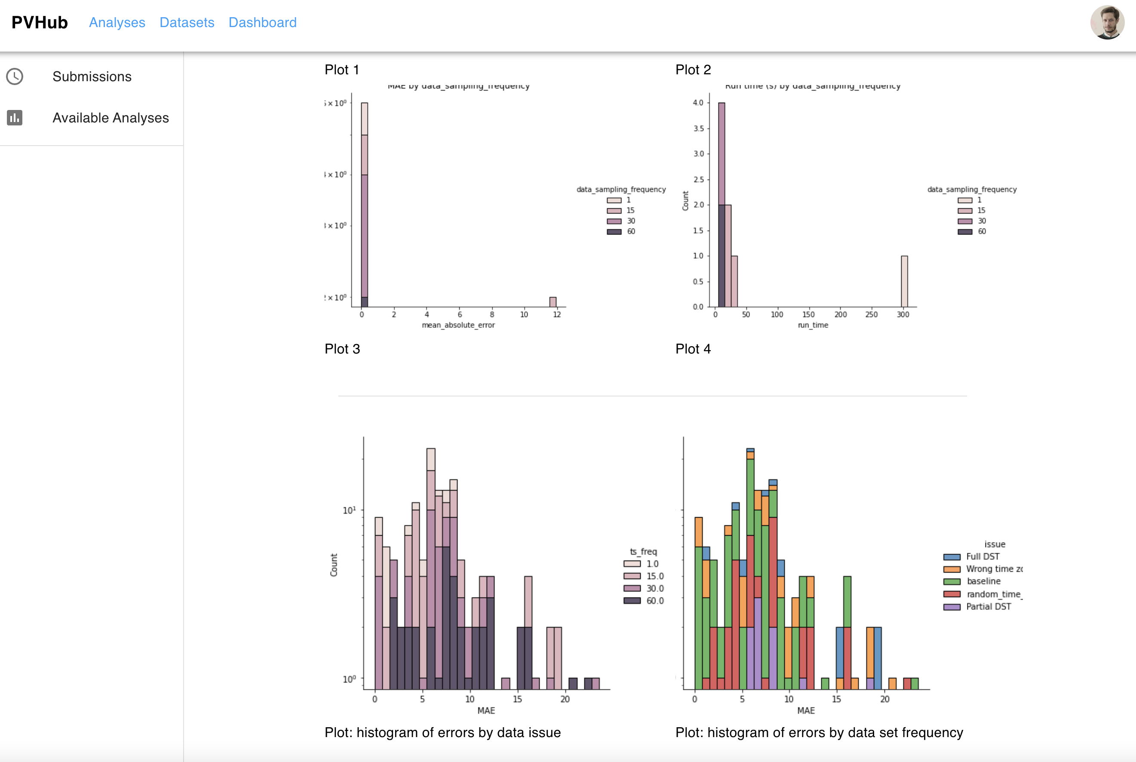
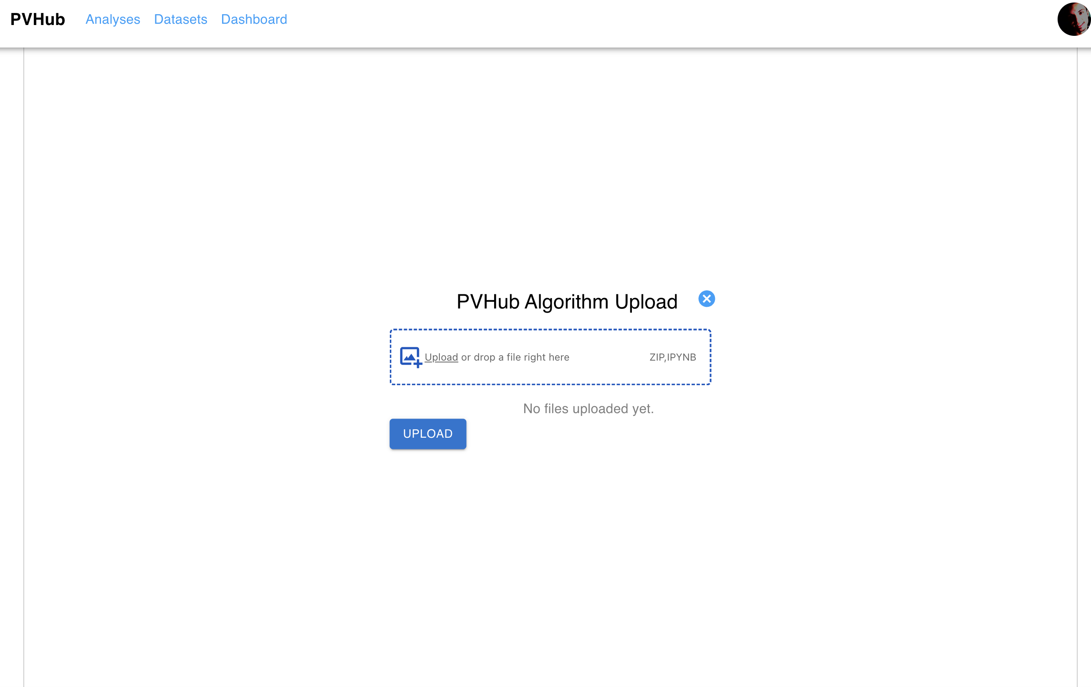
Funded by:
PV Validation Hub
B. Meyers¹, Duncan Ragsdale¹, K. Perry², Michael Deceglie², Matthew Muller², Mehmet Ogut³, Sara Miskovich¹, Mayank Malik¹
(1) SLAC National Accelerator Laboratory, Menlo Park, CA 94025, USA
(2) National Renewable Energy Laboratory, Golden, CO 80401, USA
(3) Stanford University, Palo Alto, CA 94305, USA
Purpose
Algorithm Validation
The PV Validation Hub website will allow developers in the PV community to submit executable code to benchmark against hosted sets for various problems.
One-stop shop for benchmarking and comparing algorithm performance for a variety of PV-related problems (degradation, soiling, etc.)
Consistent labeled data sets allow for side-by-side comparison of different algorithms
Enables rapid development and benchmarking of solar algorithms
Plans to generate validation tests for the following types of analyses:
Estimating system degradation
Estimating soiling rate/ratio\
Detecting time zone/shift issues
Estimating azimuth and tilt of a PV system
Determining inverter ‘clipping’ intervals
And more!
Robust Ground Truth Data Sets
Labeled measured data
Synthetic data sets with typical field data issues (capacity issues, outages, soiling, shading, etc.)
Validation Hub Outputs
Developer Role
Public reporting: Scoreboard benchmarking all submitted algorithms’ performance
Private reporting: Detailed results returned to the developer, including how the algorithm performs in certain scenarios (ex: data at different sampling frequencies)
User Role
View leaderboards and access submitted algorithm solutions for each category
Validation Hub In Action
Plan to have the Validation Hub available for public use by the end of 2023 (tentatively)
Currently benchmarking functions in the Python Solar-Data-Tools and PVAnalytics packages and using this as a framework for initial testing in the Validation Hub
Create account
Submit code for designated analysis
Code runs on validation engine
Leaderboard updated
Private report sent to developer
Current website design screenshots:
Validation Hub algorithm submission process
Main page of the site
Page to scroll through different analytical tasks
Take our feedback survey:
ADD QR CODE HERE LINKING TO SURVEY
Website page for the public leaderboard (for time shift detection)
Website page for an example private report sent to the developer
Algorithm upload page
This work was supported by the U.S. Department of Energy under Contract No. XXXX with the SLAC National Accelerator Laboratory, the National Renewable Energy Laboratory, and Stanford University.

